Slide 1


Nuclear Jumpstart Kit
This deck is intended for internal conversations, but feel free to repurpose the following slides for client conversations
2025

Slide 2
Executive Summary
The United States is the world’s largest provider of nuclear power. Yet, we are behind. Our energy needs are beginning to outpace our energy infrastructure, and to avoid a crisis, the U.S. needs to adapt. The nation’s response is taking myriad forms across the private and public sectors, but a shift towards nuclear power could alleviate our power needs for generations to come. Utilities, regulators, engineering firms, and nuclear power and fuel startups are investing billions to make nuclear power a clean and commercially-viable power solution, but as they approach full-scale deployment, they’re facing a series of problem that no one of these organizations can solve. To bring nuclear power to market, companies need an energy partner. They need Deloitte.
This presentation provides an overview of the nuclear value chain along with its key players and challenges. It also includes proposed solutions, capabilities, quals, and eminence that Deloitte’s commercial Energy, Resources, and Industrials (ER&I) practice can provide to clients to address the nuclear industry’s greatest challenges.
CHALLENGES
SOLUTIONS
Financing
Risk Management
Financing Strategy
Risk Analysis
Regulatory
Technology Strategy
Regulator Expertise
Technology Reviews
Public Perception
Workforce
Outreach Planning
Workforce Planning
Business Development
Cyber & Physical Security
PMO Experts
Risk Management
Supply Chain & Sourcing
Cost Optimization
Value Chain Experience
Cost Management
By providing services to organizations across the nuclear value chain, Deloitte will establish a footprint in an industry primed for significant growth in the coming years. Nuclear companies will become leaders in the U.S. energy industry, and Deloitte can become their trusted partner for decades to come if we establish these relationships today.

Slide 3
Contents
5 SECTION 1
Nuclear Sector Overview
13 SECTION 2
Challenges & Solutions
24 SECTION 3
Quals & Eminence
32 SECTION 4
Appendix

Slide 4
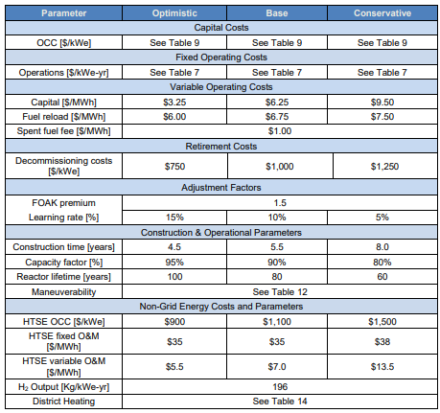
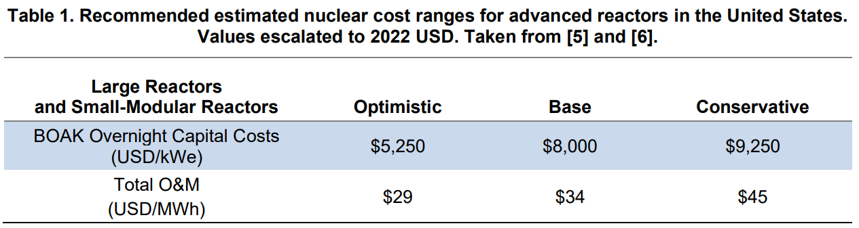
Nuclear Consulting Services Market Sizing
There is a significant market for consulting services in the nuclear space, and Deloitte can gain a first-mover advantage by acting now.
Deloitte could secure $461M in nuclear consulting revenue over the next decade
Year | Cost of Capital | U.S. Energy Production | Nuclear Capital Costs | Professional Services Market (2% - 3%) | Deloitte Market Capture (5%)
2023 | $6.54 / MWh | 777M MWh | $5.08B | $102M - $152M | $5.1M - $7.6M
2035 | $7.87 / MWh | 995M MWh | $7.83B | $157M - $235M | $7.85M - $11.8M
OPERATIONS
Years | Overnight Capital Costs | U.S. Energy New Nuclear Development | Nuclear One-Time Capital Costs | Professional Services Market (2% - 3%) | Deloitte Market Capture (5%)
Next 10 | $8,000 / kW | 35GW | $311B | $6.22B - $9.33B | $311M - $467M
DEVELOPMENT
*All Prices in 2025 Dollars, 2.33% Inflation
Assumptions
All cost inputs are based on research from the Argonne and Idaho National Laboratories. See the attached study for further assumptions.
2023 is the last date accurate generation data was available in the United States. The EIA’s 2024 report will come out Fall 2025.
This estimate accounts for business from utility-scale nuclear generators. This will include SMRs as they become commercially viable, but it does not include business from pre-deployment startups or other parts of the nuclear value chain.
Deloitte’s business would be part of a company’s capital expenses, and we would not participate in plant operations and maintenance.
Overall potential market capture based on the DOE’s base case values (see attached), a professional services market size of 2.5% total capital costs and 5% Deloitte market capture. This is a “middle of the road” estimate – not the most conservative or the most aggressive.
Assumes deployment of 3.5GW of new nuclear generation per year until 2035. In reality, deployment will skew towards the end of the decade
Notes:
Nuclear Power in the USA - World Nuclear Association
US electricity demand to grow 2.5% annually through 2035: BofA Institute | Utility Dive
In the USA, publicly-owned nuclear is actually increasing… — Profiles in Decarbonization
NZW09 Nuclear Energy Cost Estimates for Net Zero World Initiative.pdf
Inflation Expectations

Slide 5
Nuclear Energy Overview

Slide 6

How Nuclear Energy is Made
HOW IS FUEL MADE?
Mining & Milling
Commercial ore is mined and milled into a concentrate called yellowcake powder U₃O₈
Conversion
Yellowcake is converted into uranium hexafluoride (UF₆ gas)
Enrichment
Uranium isotopes are separated in a series of centrifuges to produced enriched UF₄ gas
Fuel Fabrication
UF₆ gas is chemically processed to form uranium dioxide (UO₂) powder, then compressed into fuel pellets
Recycling
The constituents of the spent fuel are separated into new fuel and waste products
HOW IS ENERGY CREATED?
Fuel Storage
Used fuel can be recycled or stored for ultimate geologic disposal
Power Plant
Pellets provide heat to produce electricity.
Waste Disposal

Slide 7
Strategic Design & Planning
Construct & Build
Production & Operation
End Use
Design & Development
Financial Planning
Program Planning
Financial Planning
Program Planning
Program Operations
Operations Preparation
Construction
Production
Operations & Maintenance
Storage & Transportation
Decommissioning
Dismantling
Strategic Development & Visioning
Financial Planning & Funding Strategy
Project Structuring & Governance
Budget Tracking & Control
Site Acquisition & Leasing
Supply Chain / Procurement Optimization
Fuel Supply Sourcing
Preventative Maintenance
Waste Management
Buyer / Lease Identification
Market & Economic Analysis
Regulatory & Compliance Analysis
Capital Allocation Planning & Management
Capital Prioritization & Reallocation
Asset Lifecycle Management
Tax Compliance & Incentive Utilization
Production Monitoring (Asset Monitoring)
Process Optimization
Route Optimization
Refurbishment & Decom. Planning
Energy Needs Assessment
JV Development & Structuring
Integrated Program Planning
Financial Reporting
License & Regulatory Planning & Permitting
Construction Vendor Selection & Management
Supply Negotiation & Optimization
Predictive Operations
Advanced Leak Detection
Sustainability Goals
Structuring & Capital Optimization
Physical / Cyber Risk Assessment & Planning
Community Engagement & Workforce Enablement
Energy Mix & Procurement
Technology & Innovation Planning
Secure Operations
Business Case & Business Planning
Due Diligence & Investor Readiness
Stakeholder Management
Debt Mgmt & Interest Rate Optimization
Outage Planning (e.g,. Resource & Workforce)
Construction Delivery Audit
Regulatory & Compliance Management
Tax Planning & Structuring
Stakeholder Engagement & Change Mgmt
Results Realization PMO
Waste Management Planning
Construction Sequencing & Progress
Regulatory Planning
Rate Case
UAV Construction Site Management
Site Identification & Validation
Licensing & Regulatory Planning
AI & Advanced Analytics
Emergency / Safety Management
Workforce Transformation
AI Digital Assistant
Digital Twin Simulations
Infrastructure / Asset Inspection
Preventative Measures
Predictive Measures & Planning
Incidence Response & Compliance
Workforce Planning
Worker Strategy & Monitoring
Supplier & Vendor Contractors
Robotic Training
Scenario Modeling
Advanced Analytics
Worker Performance & Productivity
Worker Enablement & Training
Notes:
https://www.bbc.com/news/business-61483491
The US must ramp up generation capacity to meet soaring electricity demand.
We all know there is a need to increase the generation capacity to meet the forecast electricity demand in the US.

Slide 8
Nuclear Asset Catalog
Ownership Profile
The United States’ 94 nuclear reactors are distributed across 54 power plants, largely on the east coast and in the Midwest and Southeast
Investor-owned Utility (IOU) | 82
Federal Utility | 7
Joint Ownership | 3
Joint Action Agency | 1
Municipal Utility | 1
These plants give the US more than 95,000 MW of nuclear generation capacity. Each year, this accounts for ~20% of domestic energy production
Plans for future nuclear plants fall into two categories: restarting existing plants and building SMRs (Small Modular Reactors)
While legacy utilities dominate the ownership of existing plants, many future reactors will be owned by new nuclear power players
As nuclear power becomes indispensable, Deloitte has an opportunity to play a central role in developing and operating nuclear power assets
1. Global Newswire (Source) | 2. Global Newswire (Source) | 3. White House (Source)

Slide 9
Who Needs Nuclear Power
The US is the largest global consumer of Nuclear power, accounting for almost 30% of the world’s Nuclear power consumption. Nuclear power accounts for ~20% of total US power Generation mix and 55% of Carbon-free electricity
Customers: Commercial & Residential
Data Centers
Provides carbon-free power to 28 states (IL, SC, NH receive >50% of power from nuclear
Rise in AI workloads which require significant computing power and energy consumption to operate servers and cooling systems, nuclear provides a reliable carbon-free power source
Department of Defense
Medical
Largest consumer of energy in the US. Powers submarines, aircraft carries and other infrastructure. Exploring how to incorporate nuclear into forward and remote bases
Used for early disease detection, diagnosis and treatment of diseases through advanced imaging and radiopharmaceuticals
Chemicals Industry
Space Programs
Industry focus on carbon abatement, nuclear energy provides carbon-free power to plants and heat to support creating synthetic fuels, hydrogen production and material modifications
Provides solar-independent propulsion and power for spacecraft with minimum need for refueling and maintenance
Research & Development
Desalination
Dedicated reactors generate neutron beams to study materials at the atomic level. Includes medical, agriculture, material testing, forensic and environmental science
Provides electricity and heat to remove salt and minerals from seawater for reliable and sustainable solution for water scarcity. Successfully used on US Navy nuclear fleet

Slide 10
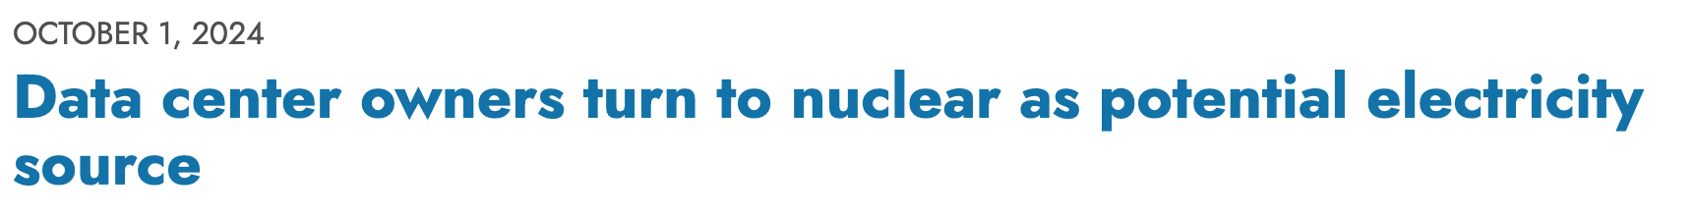
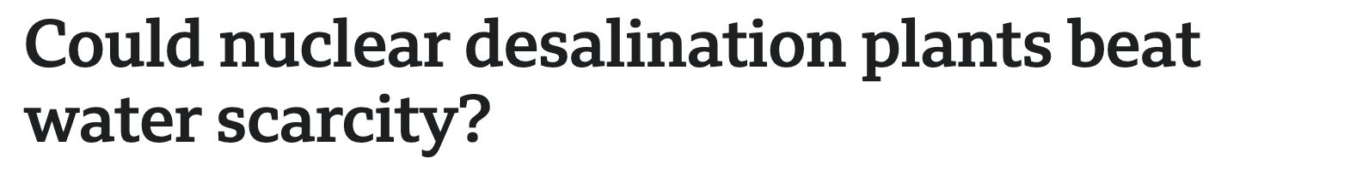
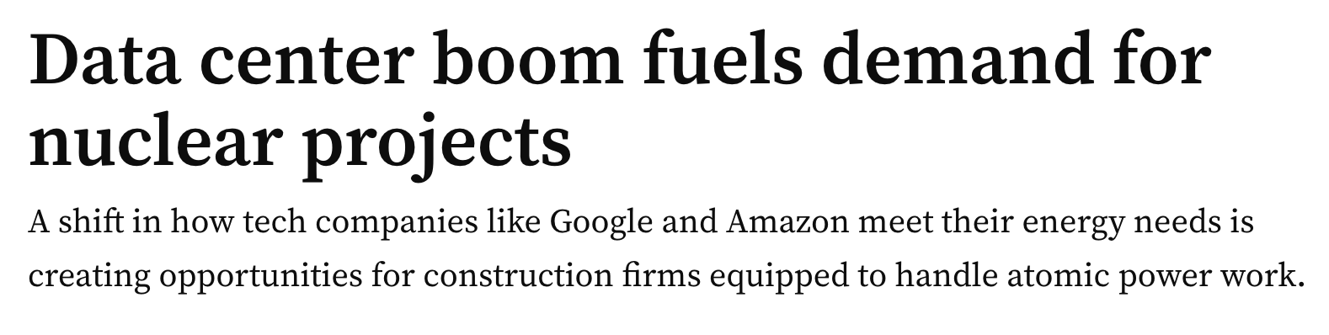
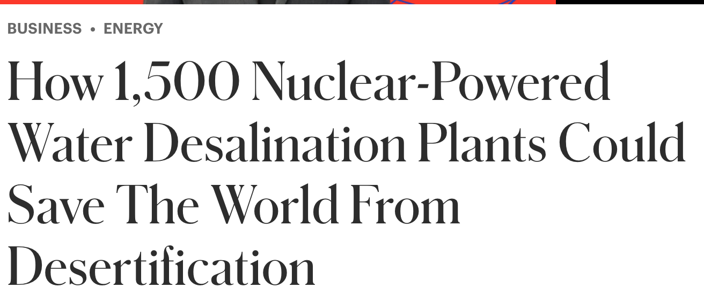
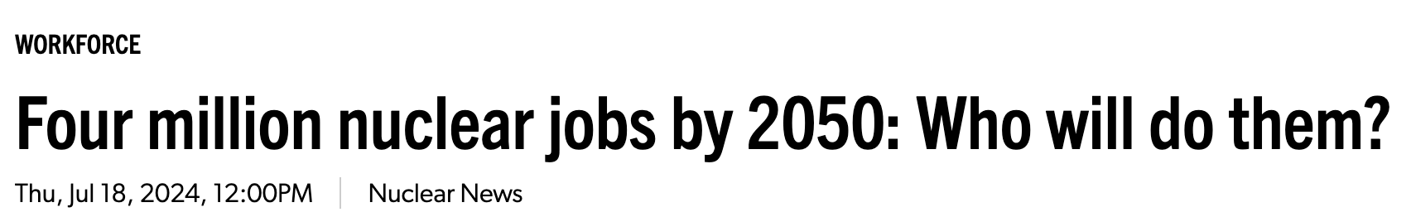
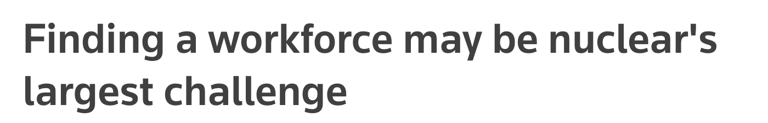
Why Now?
The US must ramp up generation capacity to meet soaring electricity demand. Nuclear is key to closing that gap.
NUCLEAR IN THE NEWS
Rising Generation Demands across both public and private sectors
The DOE has set targets to triple nuclear capacity by 2050, adding 200 GW to meet future power demands and achieve net-zero emissions by 2050
US energy consumption forecasted to increase up to 15% by 2050 driven by increased demand in Industrial, Transportation, Residential, and Commercial sectors with Data Centers alone estimated to reach 35 GW by 2030
Energy efficient solutions like Nuclear can solve high consumption demands for Data Centers
Innovative Technology like Small Modular Reactors (SMRs) can help address water scarcity
Large-scale light-water reactors, new small modular- and microreactor designs could all be built in the early 2030s to help meet the power needs of customers and the military
Specialized Workforce is aging and demands are growing
To meet growing needs, $100M in FY24 was allocated to the DOE for Nuclear Reactor Safety Training and Workforce Development. It is believed that ~75% of current coal plant jobs can transition to nuclear with minimal reskilling to meet workforce demand.
Notes:
https://www.bbc.com/news/business-61483491
The US must ramp up generation capacity to meet soaring electricity demand.
We all know there is a need to increase the generation capacity to meet the forecast electricity demand in the US.

Slide 11

Nuclear Key Players (Technical)
Nuclear Innovators | Develop advanced nuclear technologies such as small modular reactors (SMRs), fusion, or next-gen fission systems.
Manufacturing | Produce specialized components, systems, and materials essential for building and maintaining nuclear facilities.
E&C Firms | Design and construct nuclear power plants and infrastructure
Utilities (Generation) | Operate nuclear power plants and generate electricity from nuclear energy.
Utilities (Transmission) | Manage the infrastructure that transmits electricity generated by nuclear power.
Nuclear Fuel | Supply, enrich, fabricate, and recycle nuclear fuel used in reactors.
Workforce | Nuclear skilled labor, engineers, scientists, and technicians.
Non-Profit Researchers | Conduct independent studies and innovation efforts in nuclear science, safety, and technology development.
Regulators | Set safety standards, issue licenses, and oversee compliance for nuclear operations and materials.
Notes:
Nuclear Power in the USA - World Nuclear Association
US electricity demand to grow 2.5% annually through 2035: BofA Institute | Utility Dive
In the USA, publicly-owned nuclear is actually increasing… — Profiles in Decarbonization
NZW09 Nuclear Energy Cost Estimates for Net Zero World Initiative.pdf
Inflation Expectations

Slide 12
Nuclear Key Players (Non-Technical)
Investors | Provide capital to fund nuclear projects, startups, or infrastructure across the nuclear energy value chain.
Legal | Offer counsel on licensing, liability, regulatory compliance, and transactional matters in the nuclear sector.
Insurers | Provide risk coverage for nuclear facilities, including protection against operational, environmental, and liability risks.
Professional Services | Support nuclear organizations with consulting, accounting, auditing, and advisory services.
Consumers | End-users that consume electricity generated from nuclear energy sources.
NGOs & Alliances | Advocate for nuclear energy, policy reform, safety, sustainability, and public awareness.
Notes:
Nuclear Power in the USA - World Nuclear Association
US electricity demand to grow 2.5% annually through 2035: BofA Institute | Utility Dive
In the USA, publicly-owned nuclear is actually increasing… — Profiles in Decarbonization
NZW09 Nuclear Energy Cost Estimates for Net Zero World Initiative.pdf
Inflation Expectations

Slide 13
Challenges & Solutions

Slide 14
Overview
Nuclear players face a wide range of challenges and need a partner with expertise across the value chain
Business Development
Securing buyers for nuclear technology and services requires deep market knowledge and advanced contracting capabilities
Cost Optimization
A fear of cost overruns and profitability limits mean nuclear power players must keep a vigilant eye on their costs
Financing
Nuclear projects require significant upfront capital from a variety of sources, both public and private
Cyber & Physical Security
Nuclear power is a national security imperative and a risk. Companies must make security a priority from day one.
Public Perception
Americans, in general, have a negative perception of nuclear energy that increases regulation and suppresses markets
Risk Management
Companies must have strict protocols in place to manage risks to their constituents and their bottom line
Workforce
Much of America’s energy workforce is nearing retirement, and nuclear power projects could stall without the needed support
Supply Chain & Sourcing
The nuclear supply chain is complicated, international, and highly-regulated
Technology Strategy
Managing a new nuclear business will require integrating new technologies into a complicated existing ecosystem
Regulatory
The U.S. nuclear industry is the most regulated in the world and subject to changes depending on the political environment

Slide 15
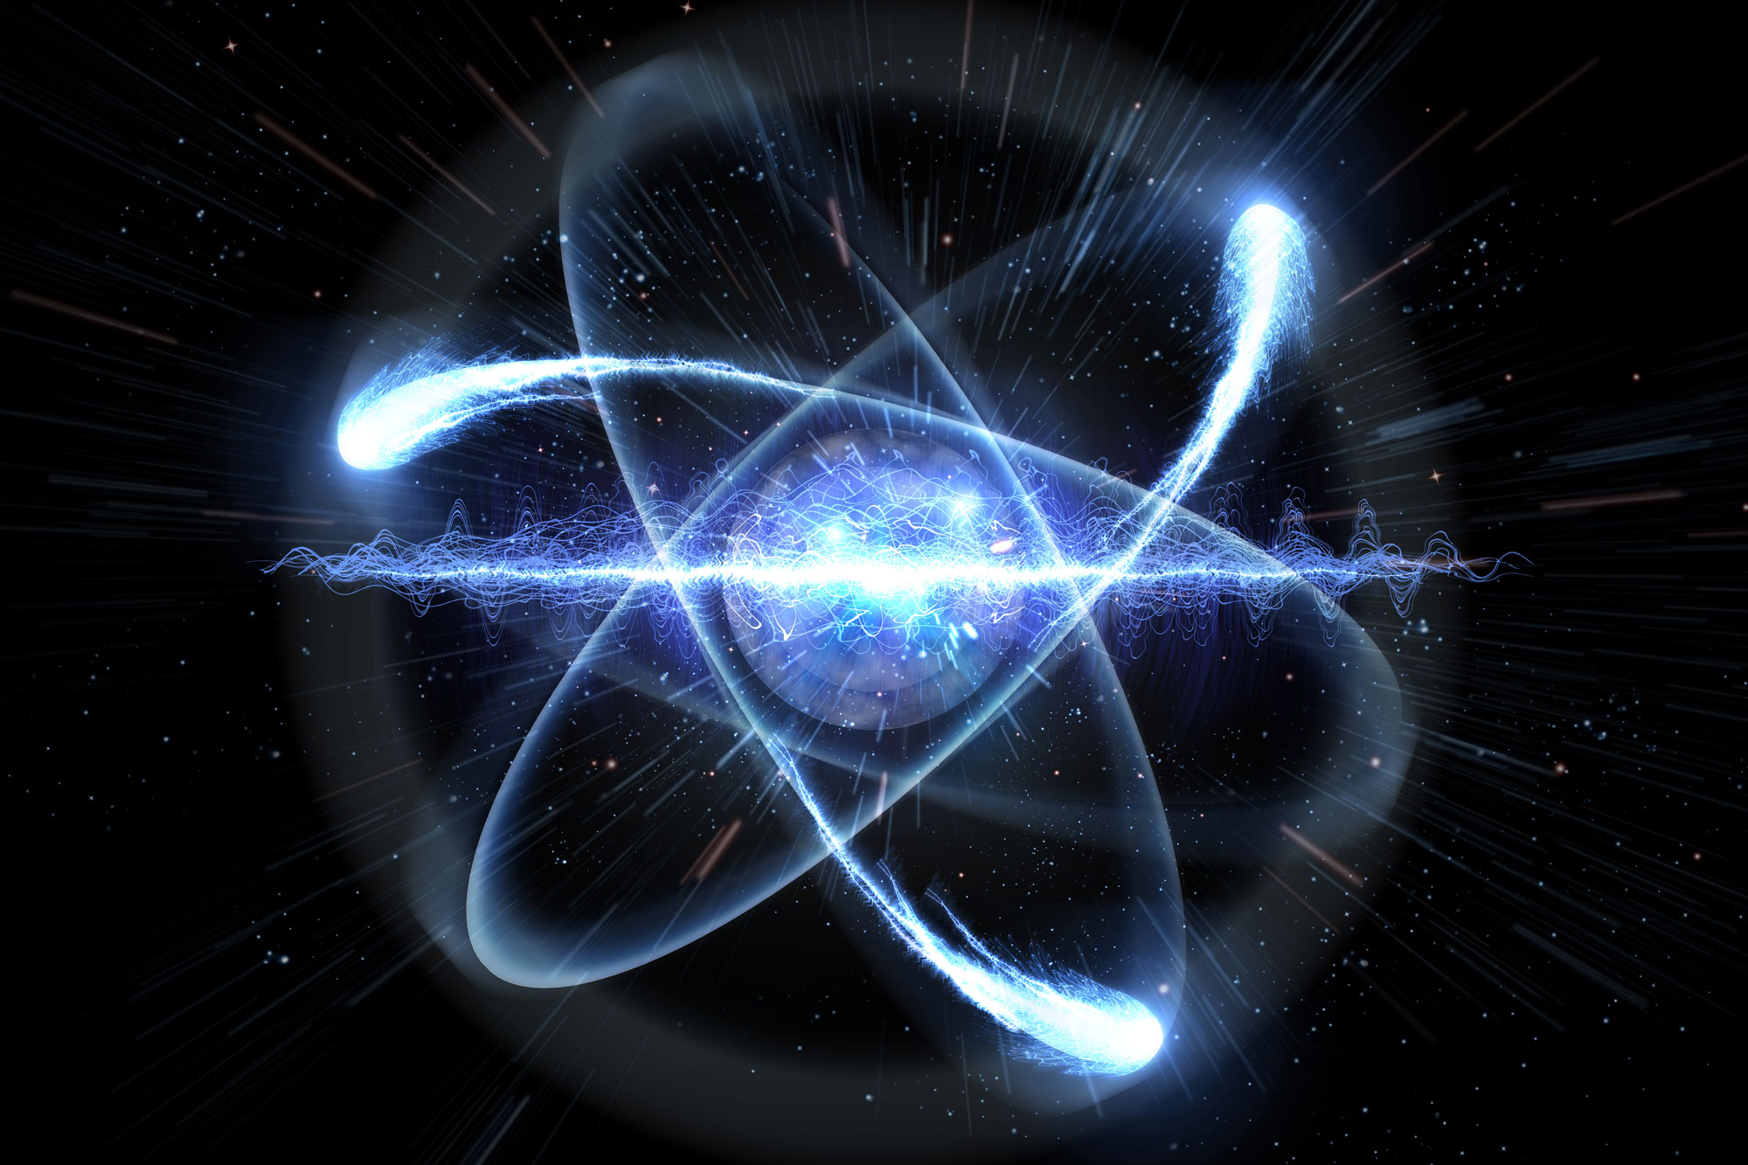
Business Development
The nuclear power industry is a fast-evolving space, and companies need help navigating their needs and defining a strategy to secure reliable long-term demand
Key Players: Utilities, Nuclear Innovators, Consumers
THE CHALLENGE
OUR SOLUTIONS
PPA Negotiation
Nuclear power’s long development cycles and rigid delivery models are poorly aligned with today’s flexible contracting approaches. Structuring viable off-take agreements remains difficult given pricing volatility and credit risk concerns. M&A and capital markets activity in the sector are hampered by unclear growth trajectories and investor risk aversion. Strategies for securing reliable demand are especially important for enabling innovators to take advantage of efficiencies as they move from FOAK to NOAK reactor builds.
Partner Selection
JV Structuring
Stakeholder Engagement
PPA Negotiation
Carbon Credit Sourcing
Deal Negotiations
Energy Needs Assessment
Market Economic Analysis
Buyer Lease Identification
Transact/Refurbishment Planning
Customer Segment Analysis
Demand Forecasting
Negotiating PPAs can be complex due to fluctuating market conditions and the need for long-term stability. Deloitte assists nuclear power players in PPA negotiations by providing market insights, financial modeling, and strategic advice, ensuring that agreements are structured to maximize value and mitigate risks for all parties involved.
Demand Forecasting
KEY ISSUES
Accurately predicting energy demand is essential for optimizing operations and maintaining a reliable power supply. Deloitte offers advanced demand forecasting solutions, utilizing data analytics and modeling techniques to help nuclear power players predict future energy needs, optimize production schedules, and ensure efficient resource allocation.
Contract Complexity
Long Lead Times
Counterparty Risk
ROI Uncertainty

Slide 16
Financing
Nuclear development is capital-intensive, and clients need a partner who can secure funding from a variety of sources while lowering their capital costs and aligning their financing strategy with long-term goals
Key Players: Investors, Nuclear Innovators, Utilities, E&C Firms, Consumers
THE CHALLENGE
OUR CAPABILITIES
Financial Planning
Nuclear projects require enormous capital, both upfront and across the development lifecycle, creating significant barriers for private investors and utilities. The long lead times and uncertain returns deter typical infrastructure backers, particularly in competitive markets with lower-cost renewables. Investment risk is amplified by historical budget overruns and changing regulatory or political landscapes.
Financial Planning
Strategy
JV Development
Capital Optimization
Investment Simulation
Cost Management
Tax Planning Strategy
Financial Risk Assessment
Due Diligence Readiness
Profit/Loss Sharing
Financial Reporting
Debt Portfolio Management
Tax Incentive Utilization
Financial Modeling
Nuclear power projects require meticulous financial planning to balance capital investment with long-term operational costs and revenue generation. Deloitte offers strategic financial planning services, helping nuclear power players structure their financing, optimize cash flow, and develop sustainable financial models to support both short-term goals and long-term growth.
JV Development
KEY ISSUES
Collaborating with external partners in nuclear power projects can be challenging due to differences in goals, risks, and expertise. Deloitte helps nuclear power players navigate joint venture development by providing strategic guidance, risk assessment, and integration support, ensuring successful partnerships that maximize value and enhance operational efficiency.
Capital Requirements
Investor Risk Aversion
Long Payback Period
Policy Dependency

Slide 17
Public Perception
The American public is concerned about the safe deployment, operation, and decommissioning of nuclear assets, and companies need a skilled partner to hone their message and secure approval
Key Players: Utilities, Nuclear Innovators, Regulators, Consumers, NGOs
THE CHALLENGE
OUR CAPABILITIES
Environmental Impact Assessment
Persistent concerns about safety, waste disposal, and historical accidents continue to shape public skepticism. Additional pushback can arise when local communities feel that they are excluded from planning conversations or from opportunities to access economic benefits afforded by the project. Community resistance can delay or derail projects even when technical feasibility is high. Brand-level perception challenges also limit broader political and customer support.
Public Response Planning
Environmental Impact Assessment
Stakeholder Management
Transparency Enablement
Incident Reporting Systems
Community Engagement
Long-Term Monitoring
ESG Considerations
Nuclear projects must carefully assess and mitigate their environmental impact to ensure regulatory compliance and public trust. Deloitte provides comprehensive environmental impact assessments, helping nuclear power players identify potential risks, evaluate sustainability, and implement strategies to minimize environmental effects while adhering to regulatory standards.
Community Engagement
KEY ISSUES
Building and maintaining positive relationships with local communities is vital for the long-term success of nuclear power projects. Deloitte supports nuclear power players in community engagement efforts, offering strategies for transparent communication, addressing public concerns, and fostering partnerships that promote mutual understanding and support for nuclear operations.
Safety Stigma
Waste Fears
NIMBY-ism
Local Regulatory Authority
Local Economic Impacts

Slide 18
Workforce
Like the energy industry at large, nuclear developers and operators are facing a wave of retirements; Companies need a workforce strategy to ensure their plants have cost-effective and competent operators
Key Players: Utilities, Nuclear Innovators, E&C Firms, Nuclear Fuel Firms, Universities
THE CHALLENGE
OUR CAPABILITIES
Workforce Planning
An aging workforce and limited new talent pipeline present a significant capacity challenge across engineering, operations, and regulatory functions. Specialized nuclear skills are in decline due to decades of underinvestment in workforce development. Labor constraints affect both current plant operations and future project feasibility.
Workforce Planning
AI Recruitment
Skills Assessment
Personalized OHS Training
Human Equity Development
Learning & Development
Shift Planning
Talent Strategy
DEI Planning
Effective workforce planning is crucial in the nuclear sector to ensure the right skills are available at the right time to meet operational demands and regulatory requirements. Deloitte assists nuclear power players in developing robust workforce strategies, optimizing talent acquisition, succession planning, and resource allocation.
Learning & Development
KEY ISSUES
As the nuclear industry evolves, continuous training and development are essential to maintain a skilled, knowledgeable workforce. Deloitte offers tailored learning and development programs, focusing on industry-specific competencies, safety standards, and leadership capabilities, empowering nuclear power players to foster a culture of continuous improvement and drive workforce excellence.
The “Retirement Wave”
Weak Talent Pipeline
Regulatory Bottlenecks
Training Deficits

Slide 19
Technology Strategy
Adding nuclear power to the nation’s energy portfolio will require companies across the value chain to integrate new, highly-regulated assets with significant data challenges
Key Players: Utilities, Nuclear Innovators, Nuclear Fuel, E&C Firms
THE CHALLENGE
OUR CAPABILITIES
Digital Transformation
Nuclear operators face aging digital infrastructure and fragmented IT systems. Modernizing enterprise platforms such as asset management and real-time analytics is difficult due to regulatory constraints, legacy investments, and lack of standardization. These challenges hinder efficiency, visibility, and long-term digital scalability across the enterprise.
Digital Transformation
Cloud Managed Services
IT Service Management
Digital Twin Simulations
Predictive Maintenance
Data Science & Analytics
AI Digital Assistants
Application Management Services
Technology & Innovation Planning
Regulatory Tech Enablement
Deloitte addresses digital challenges by guiding nuclear clients through strategic digital transformation initiatives, leveraging proprietary frameworks like Deloitte’s Digital Maturity Model and cloud-based solutions to modernize operations, enhance safety, and optimize performance across their entire value chain.
Data Science & Analytics
KEY ISSUES
Deloitte provides advanced data science and analytics capabilities—including AI-driven predictive maintenance models and Deloitte's CortexAI™ platform—to help nuclear companies proactively manage equipment reliability, streamline regulatory compliance, and improve overall operational decision-making.
Legacy IT Systems
IT Fragmentation
Data Silos
Limited Automation
Data Governance

Slide 20
Cost Optimization
Cost is significant fear in an industry where overruns can last years and cost billions of dollars; Developers need a partner that can work across the value chain to deliver on-time and on-budget
Key Players: Investors, Nuclear Innovators, Utilities, E&C Firms, Consumers, Insurers
THE CHALLENGE
OUR CAPABILITIES
Energy Trading Analysis
The industry faces persistent difficulty in controlling construction and operating costs, with large-scale projects regularly exceeding budgets and schedules. Fixed-cost structures, supply chain complexity, and custom design elements all contribute to inefficiencies. These challenges strain project feasibility and erode investor confidence.
Planning Optimization
Process Optimization
Cost Estimation
Capital Efficiency Review
Operational Cost Management
Energy Trading Analysis
Scenario Modeling
Anomaly Detection
Worker Productivity
Learning & Capability Development
Budget Tracking Control
Performance Monitoring
Navigating the complexities of energy trading requires understanding market dynamics, pricing fluctuations, and regulatory changes. Deloitte offers advanced energy trading analysis services, using data-driven insights and market expertise to help nuclear power players optimize trading strategies, manage risk, and capitalize on emerging opportunities in global energy markets.
Budget Tracking Control
KEY ISSUES
Budgeting is essential for staying within budget while meeting safety and regulatory standards. Deloitte leverages advanced tools and methodologies to optimize resource allocation, improve forecasting accuracy, and ensure that projects remain financially viable from start to finish.
Inadequate Benchmarking
Construction Overruns

Slide 21
Cyber & Physical Security
All parts of the nuclear value chain are targets; Ensuring their security requires expertise and experience in managing sensitive, large-scale projects
Key Players: Utilities, Consumers, Regulators
THE CHALLENGE
OUR CAPABILITIES
Cyber Program Management
Nuclear facilities are inherently high-risk assets, making them targets for increasingly sophisticated cyber and physical threats. As the landscape trends towards a high volume of smaller-scale reactors, owners/operators will need to adapt strategy to balance security across multiple sites. The sector must manage aging digital infrastructure while contending with rapidly evolving attack vectors. Regulatory expectations around security continue to tighten, adding complexity and cost to operations.
Security Measures
Cyber Program Management
Physical Security Access
Security Operations
IT Service Management
Radiation Monitoring
Risk Assessments
Chain of Custody
Emergency Preparedness
Secure Operations
Engineering Grade Scans
Compliance Monitoring Systems
With the growing risk of cyber threats, nuclear power players must safeguard critical infrastructure and sensitive data. Deloitte provides robust cybersecurity program management, offering tailored strategies, threat monitoring, and compliance solutions to protect assets and ensure the resilience of nuclear operations against evolving cyber risks.
Risk Assessments
KEY ISSUES
Identifying and mitigating risks is crucial in the nuclear sector due to high-stakes operations and regulatory scrutiny. Deloitte offers comprehensive risk assessments, leveraging advanced methodologies to analyze potential threats across safety, security, financial, and operational domains.
Legacy IT Systems
New Threat Vectors
Workforce Skill Gaps
Compliance Cost Pressures

Slide 22
Risk Management
Risk is a fundamental theme of nuclear projects, but the industry does not address risk in a consistent and holistic way; An energy partner working across the value chain can minimize risks and maximize value
Key Players: Investors, Utilities, Nuclear Innovators, E&C Firms, Nuclear Fuel Firms, Consumers, Regulators
THE CHALLENGE
OUR CAPABILITIES
Contingency Planning
The industry operates under low tolerance for error across financial, operational, and reputational dimensions. Projects are subject to significant physical risk throughout the construction and operation lifecycle and require robust emergency planning. Additional project risk is exacerbated by long durations, uncertain cost trajectories, and evolving regulatory oversight. Internal risk controls are often siloed and reactive rather than integrated into forward-looking strategy.
Risk Analyses
Contingency Planning
Critical Response
Advanced Monitoring Analytics
Predictive Maintenance
Audit Support
Insurance & Liability Management
Climate Risk Governance
Physical Safety Monitoring
Chain of Custody Tracking
Safety Protocol Development
Unforeseen events and disruptions can pose significant challenges to nuclear power operations, making contingency planning essential. Deloitte helps nuclear power players develop comprehensive contingency strategies, ensuring preparedness for emergencies and minimizing the impact of unexpected events on operations, finances, and compliance.
Insurance & Liability Management
KEY ISSUES
Managing insurance and liability risks in the nuclear sector is crucial due to the potential for high-stakes incidents. Deloitte offers specialized insurance and liability management services, assisting nuclear power players in structuring optimal coverage, assessing risks, and ensuring compliance with regulatory requirements, all while protecting against financial and operational exposures.
Volatile Cost Estimates
Regulatory Exposure
Siloed Risk Controls
Insurance Limitations
Emergency Management

Slide 23
Supply Chain
Companies rely on international partners and underdeveloped local players, and they need support navigating changing regulatory and market environments
Key Players: Utilities, Nuclear Innovators, E&C Firms, Nuclear Fuel Firms
THE CHALLENGE
OUR CAPABILITIES
Supply Chain Optimization
The domestic nuclear supply chain suffers from gaps in critical component manufacturing, workforce specialization, and fuel cycle capabilities. Reliance on international suppliers for key inputs introduces geopolitical risk and delivery uncertainty. These structural deficiencies constrain scalability and delay deployment timelines. As novel advanced reactors move from testing to commercialization these limitations will be felt even more acutely as they establish entirely new supply chains.
Supplier Network Intelligence
Supply Chain Optimization
Vendor Selection
Procurement Strategy
Autonomous Supplier Data
UAV Construction Management
Transport Carrier Negotiation
Route Optimization
Material Management
Inventory Management
Contract Negotiation
Logistics Planning
The nuclear industry relies on a complex and global supply chains that must be efficient and resilient. Deloitte helps nuclear power players optimize their supply chains by streamlining processes, enhancing visibility, and implementing advanced technologies to reduce costs, improve performance, and mitigate supply disruptions.
Vendor Selection
KEY ISSUES
Choosing the right vendors is critical in the nuclear sector to ensure quality, reliability, and compliance with stringent regulations. Deloitte supports nuclear power players in vendor selection by providing data-driven insights, risk assessments, and strategic guidance to identify the best partners, ensuring the right balance of cost, capability, and compliance.
Fuel Sourcing
Long Lead Times/Procurement Process
Vendor Concentration
Regulatory Limitations for Suppliers (N-Stamp)

Slide 24
Regulatory
The United States’ nuclear industry is one of the most regulated in the world and currently undergoing significant transformation; A well-connected partner can help nuclear innovators and utilities navigate regulatory shift to deliver safe systems fast
Key Players: Regulators, Utilities, Nuclear Fuel Firms
THE CHALLENGE
OUR CAPABILITIES
Regulatory Strategy
The nuclear industry faces a highly complex regulatory landscape at a point of transition due to government efforts to streamline approvals. Despite these efforts, licensing pathways remain fragmented and unclear, especially for newer technologies. Even refined compliance will require significant time, staffing, and documentation. This creates both structural delays and ongoing cost pressures across the project lifecycle.
Regulatory Planning
Regulatory Compliance Reporting
Compliance Analytics
Environmental Reporting
Incident Response Compliance
Disaster Communication
Regulatory Strategy
Licensing & Permits
Integrated Compliance
Regulatory & Legal Diligence
Audit Planning
NERC Audit Planning
INPO Audit Planning
Navigating the complex and ever-evolving regulatory landscape is a significant challenge for nuclear power players. Deloitte provides strategic regulatory guidance, helping organizations stay compliant with industry standards, anticipate regulatory changes, and develop proactive approaches to minimize risks while maximizing operational efficiency.
Audit Planning
KEY ISSUES
Ensuring compliance and transparency through effective audits is essential for maintaining trust and meeting regulatory requirements in the nuclear sector. Deloitte offers comprehensive audit planning services, providing a structured approach to identify key risks, ensure accurate financial reporting, and strengthen internal controls, all while aligning with regulatory expectations and industry best practices.
Review Delays
Documentation Overhead
Jurisdictional Conflicts & Confusion
Regulation Ambiguity
Approval Pathway Complexity

Slide 25
Eminence + Resources

Slide 26


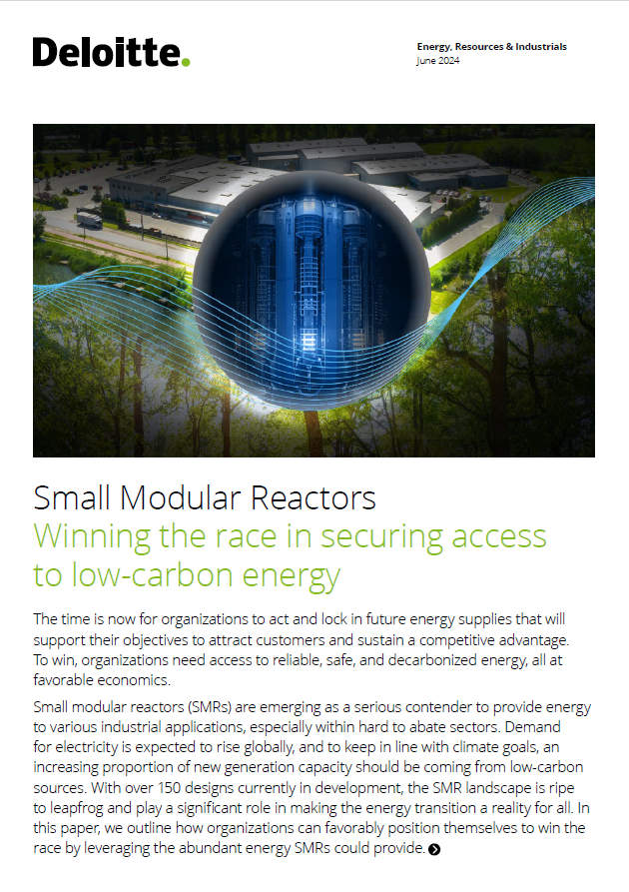

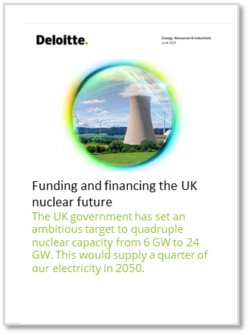

Eminence
Deloitte’s Research Center for Energy & Industrials combines rigorous research with industry-specific knowledge and practice-led experience to deliver compelling insights that can drive business impact.
Nuclear energy’s role in powering data center growth
As the electric power sector looks to address rising power demand from data centers to drive artificial intelligence growth, nuclear energy appears to be emerging as an attractive option.
2025 Power and Utilities Outlook
Highlights the evolving landscape of the power and utilities sector, driven by increasing electricity demand, technological advancements, and the transition to cleaner energy sources.
SMR: Winning the race in securing access to low-carbon energy (2024):
In this report, Deloitte discusses the benefits of SMRs, their application and what is needed to win the race to secure much needed low carbon energy.
Funding the growth in the US power sector
Electric companies are expected to make massive investments to modernize the grid to address growing electricity demand. Deloitte’s analysis outlines strategies to help fund this growth.
Funding and financing the UK nuclear future (2023)
The UK government has set an ambitious target to quadruple nuclear capacity from 6 GW to 24 GW. This would supply a quarter of our electricity in 2050. In this article Deloitte explores the actions needed to improve funding and financing of nuclear projects beyond Sizewell C.
Winning Over The Crowd: The Role of Public Opinion in Nuclear’s Success
This paper explores the shifting
landscape of public opinion towards nuclear energy and examines the factors influencing renewed interest, outlining considerations to build and maintain relationships to ensure ongoing public acceptance

Slide 27
Key Resources
Resource Name + Link | Description
Nuclear Value Chain Strategy Deck | This deck offers a high-level overview of the nuclear value chain, an assessment of the current nuclear market in the United States, an overview of Deloitte’s relevant capabilities, and an initial list of client targets in the nuclear industry.
ER&I Infrastructure Water Jumpstart Kit | This deck offers an overview of the commercial water industry along with the major challenges it faces today. It also includes details on how Deloitte will target these different challenges and grow their footprint in the water market.
ER&I Infrastructure Conferences | This is a list of relevant conferences across nuclear, water, and data centers. If you’re interested in attending one of these conferences, please reach out to our team!

Slide 28
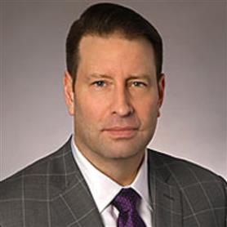


Our Team
Martin Stansbury
Principal
Sustainability Strategy, US
Adrienne Himmelberger
Senior Manager
Power, Utilities, & Renewables
Matt Knudson
Manager
Finance Strategy, US

Slide 29
Target Clients

Slide 30
Target Clients – Utilities (Sell-to)
Link to Spreadsheet
Rank | Organization (Regulated, Deregulated, or Both) | LCSP | How We Will Target | Rationale
1 | Tennessee Valley Authority (TVA) (Regulated) | Marlene Motyka | *Waiting on conversations with client teams to determine their most pressing needs and what capabilities Deloitte can offer to address them | Tennessee is a hub of nuclear innovation, and TVA is a major player in the space. They’re a major investor and partner for SMR developers, many of whom have built test sites in Tennessee. They also have a large current-state nuclear fleet (8,275MW or 24% of their generation capacity). TVA is considering building a BWRX-300 at its Clinch River site a few miles from Oak Ridge National Laboratory and the site has received NRC approval.
2 | Talen Energy (Deregulated) | NA |  | Modest nuclear fleet (2,500MW) and a leader among utilities in partnering with tech companies. Faces significant regulatory pressure to meet “clean” generation requirements by 2040.
3 | Nextera (Both) Attest | Tim Wilhelmy |  | They need to generate an estimated 30% of their power through renewable sources by 2040, but they have a limited nuclear portfolio. Managing their existing plants and expanding their nuclear footprint will be a priority in the coming years. They have been opening to add-on consulting rwork in the past and would be an excellent place to gain experience in nuclear energy transition strategy.
4 | Southern Company (Regulated) Attest | Tim Gillam |  | One of the largest nuclear fleets in the United States (~8,400MW). They’re under limited pressure to increase their renewable generation share, but they have recent regulatory and construction experience. They are an attest client, but they would be a great place to gain strategy experience on projects related to construction project management and the regulatory process for new-build plants.
5 | Constellation and/or Exelon (Deregulated/Regulated) | Mihcael Rohrig |  | With the largest nuclear fleet in the United States (20,900MW), Constellation could offer significant opportunities to support operating reactors. They’re also a leader in data center partnerships and in the process of restarting Reactor 1 at Three Mile Island.
6 | DTE Energy (Regulated) | Mike Kosonog |  | Small nuclear fleet (1,100MW), but faces significant regulatory pressure to meet Michigan’s 100% “clean” generation requirements by 2040. Also, DTE struggles with grid reliability and is facing significant pressure to upgrade its existing transmission and distribution infrastructure.
7 | Ameren (Both) | Dmitriy Borovik |  | Operates one reactor (1,279MW), but faces significant regulatory pressure to increase the share of its energy generated by “clean” sources by 2040.
8 | Duke Energy (Both) Attest | John Slyh |  | One of the largest nuclear fleets in the United States (~10,700MW). While they are an attest client and are under limited pressure to expand their renewable footprint, they could present an opportunity for Deloitte to get experience in future-proofing a large fleet of legacy reactors.
9 | Dominion Energy (Both) Attest | John Sliman |  | Operates a large nuclear fleet and faces significant regulatory pressure to increase its share of renewable generation. They are an attest client but could be a place to gain experience in nuclear strategy – especially in mitigating them impact of an aging fleet of legacy plants.
10 | First Energy (Both) | Howard Friedman |  | Modest nuclear fleet (2,320MW) and faces some regulatory pressure to meet “clean” generation requirements by 2040.
11 | American Electric Power (AEP) (Both) | Martin Stansbury |  | Operates a small nuclear fleet and faces limited regulatory pressure to increase its share of renewable generation.
12 | CPS Energy (Regulated) | Alison Walgren |  | CPS is the City of San Antonio’s municipal utility. They are one of the largest purchasers of renewable energy in Texas and a part-owner of the South Texas Nuclear Project (along with Constellation). Deloitte is developing a relationship with them, and their experience in co-managing a nuclear plant presents an opportunity to learn about unique PPA structures and advise on nuclear transition strategy.
 | *Links to Deloitte IQ

Slide 31
Target Partners – SMR Developers (Sell-to)
Link to Spreadsheet
Rank | Organization | LCSP | How We Will Target | Rationale
1 | TerraPower | Kenton Barry | *Waiting on conversations with client teams to determine their most pressing needs and what capabilities Deloitte can offer to address them | One of only a few SMR developers with a construction permit (Nuscale, Natura Resources). They’ve begun construction of a salt-cooled reactor in Wyoming, and they’re looking to be one of the first operational SMRs in the United States. Deloitte has also done work here in the past year.
2 | Holtec | NA |  | Re-starting the Palisades Nuclear facility. Once the re-start is complete, they will attempt to deploy their proprietary SMR-300 at the same site by 2030. Their “Mission 2030” program (conducted in partnership with Hyundai) could be the first full-scale SMR deployment in the United States.
3 | Nuscale | Charles Mello |  | One of only a few SMR developers with a construction permit (Terrapower, Natura Resources). They had plans to build out an SMR in Clinch River, TN. However, that plan was scrapped due to cost overrun. Deloitte has done work here in the past year.
4 | X-Energy | NA |  | Significant support from Amazon and Energy Northwest to build out data center power supply. They also have PPAs signed with several other companies and are seeking a NERC construction permit in partnership with DOW Chemical.
5 | GE Vernova Attest | Paul Rogers |  | Developing an SMR, the BWRX-300. Signed MOUs with Ontario Power Generation, TVA, and Synthos Green Energy in Poland to invest $500 million to launch the reactor at a commercial scale. Established a supplier group for the first BWRX-300, including Worley Chemetics, BWXT, and Velan. They are an attest client, but as the largest SMR developer in the world, their account could provide opportunities for business and sales strategy as they continue to sign PPAs in the United States and abroad.
6 | Kairos Power | Elizabeth Murdock |  | Building out a demonstration facility for their SMR, Hermes, in Oak Ridge, TN. Signed a 500MW power purchase agreement with Google with full deployment planned by 2035. Began building a facility to produce high-purity, molten salt coolant for Kairos Power advanced reactors, starting with the Hermes Low-Power Demonstration Reactor in Oak Ridge, Tennessee.
7 | Oklo Attest | James Davis |  | Oklo is building an SMR based on the Experimental Breeder Reactor-II, a self-regulating liquid-metal cooled reactor. Oklo is pursuing a combined license application that would give them the ability to construct and operate their reactor once approved. They’re aiming for an initial deployment in the early 2030s. They are an attest client, but partnering with them could offer Deloitte the ability to learn about and advise on their unique regulatory approach. If they’re successful, this approach could cut valuable time from the reactor deployment process.
8 | Natura Resources | James Davis |  | One of only a few SMR developers with a construction permit (Nuscale, Terrapower). They have begun construction of a salt-cooled SMR at Abeline Christian University, and that reactor is scheduled to come online in 2026. They’re aiming for a commercial deployment of their technology in 2030.
9 | General Atomics | Cory Litteken |  | GA is developing an SMR, dubbed the “Energy Multiplier Module,” that is sited in a below-grade sealed containment and uses passive safety methods for heat removal and reactivity control to protect the integrity of the fuel, reactor vessel and containment. GA is currently engaged in pre-application activities with the NRC.
10 | Rolls Royce | Kerry Millar |  | Their SMR business is Europe-based. They have not pursued licensure with the NRC, but the NRC has a memorandum of understanding with the UK Office for Nuclear Regulation that would limit licensing time in the U.S. Rolls-Royce is up to eighteen months ahead of competitors in any European regulatory process and has MOU’s with Exelon, Estonia, Turkey, and the Czech Republic.
 | *Links to Deloitte IQ

Slide 32
Target Clients – Power Purchasers (Sell-to)
Link to Spreadsheet
Rank | Organization | LCSP | How We Will Target | Rationale
1 | Amazon | Gillian Crossan | *Waiting on conversations with client teams to determine their most pressing needs and what capabilities Deloitte can offer to address them | Seeking clean, consistent energy for its data centers. Partnered with Talen Energy to co-locate at its Susquehanna Nuclear Plant. The largest buyer of “data center energy” – a space that could use 12% of U.S electricity by 2028 – and the largest buyer of clean energy in the United States.
2 | Alphabet | Randy Whitney |  | Seeking clean, consistent energy for its data centers. They have a mature power sourcing and purchasing arm that has already signed a 500MW PPA with Kairos Power. However, like all SMR deals, realizing that agreement is years away and Alphabet is in the market for much more power. Will be one of the largest buyers of “data center energy” – a space that could use 12% of U.S electricity by 2028.
3 | Meta | Jana Arbanas |  | Seeking clean, consistent energy for its data centers. New to the nuclear space, but a recent RFP shows their interest in nuclear power. Will be one of the largest buyers of “data center energy” – a space that could use 12% of U.S electricity by 2028.
4 | Microsoft Attest | Diane Wallace |  | Seeking clean, consistent energy for its data centers. They are one of Deloitte’s largest attest clients but could be a place to gain experience in SMR strategy, siting, and deployment. Will be one of the largest buyers of “data center energy” – a space that could use 12% of U.S electricity by 2028.
5 | Project Stargate (Oracle, OpenAI, Softbank) | NA |  | Seeking clean, consistent energy for its data centers. Project Stargate is a collaboration between some of the United States’ largest data center owners and the U.S. Government. They’re aiming to deploy $500B to develop data centers and will be looking to SMRs as a reliable source of power that can alleviate issues associated with siting many data centers.
6 | LyondellBasell | Christie Shopoff |  | One of the largest purchasers of clean energy in the world. LyondellBasell is a chemical manufacturer that requires significant reliable energy sources for its factories and will likely look to SMRs.
7 | DOW Chemical Attest | Shan Nemeth |  | DOW is a chemical manufacturer that requires significant reliable energy sources for its factories. They recently signed a power purchase agreement with x-Energy to deploy an SMR at one of their factories. They are an attest client but could be a great place to gain strategy experience in siting and power purchase agreement design for chemical plants.
8 | Nucor | NA |  | Nucor is the largest steel manufacturer in the world. They recently signed an MOU with Nuscale to explore deployment of SMRs at Nucor’s Electric Arc Furnace Steel Mills. The MOU also includes provisions for Nucor to supply future Nuscale projects with steel.
9 | Chevron | John England |  | Chevron has expressed significant interest in the SMR space. Their CEO has explained Chevron’s need for significant sources of reliable power (often in remote locations), and that these needs would be well-served by SMRs. Chevron Ventures, Chevron’s venture-capital wing, has invested in SMR developers, including Zap Energy and Radiant Industries.
10 | ExxonMobil | Ben Jones |  | ExxonMobil has not made many public comments on SMR development, but their industry requires significant sources of reliable energy, and they would benefit significantly from SMR deployment.
 | *Links to Deloitte IQ

Slide 33
Target Partners – E&C Firms (Sell-with)
Link to Spreadsheet
Rank | Organization | LCSP | How We Will Target | Rationale
1 | Bechtel | Sergey Shchemelev | *Waiting on conversations with client teams to determine their most pressing needs and what capabilities Deloitte can offer to address them | We have begun the partnership process and are in talks with their executives. Bechtel is responsible for some of the world’s largest infrastructure projects, and they recently completed construction of Southern Nuclear’s Vogtle Units 3 & 4.
2 | Holtec | NA |  | We’ve been invited to tour their headquarters and production facility. They are looking for a consulting partner. Holtec has engineering, utility, and energy product capabilities including the Palisades Nuclear Plant and the SMR-300.
3 | Arup | NA |  | We have begun the partnership process and recently hosted a session to establish a roadmap and protocols for partnering. They have extensive nuclear capabilities, including new nuclear build, site redevelopment, hazard reduction, decommissioning and waste management projects including long-term geological storage. They are also a major player in commercial real estate.
4 | HDR | Amy Ryan |  | We have begun the partnership process. They are a major player in the transportation industry and are partnering with Space Force and Texas A&M. They also offer management consulting services.
5 | Stantec | NA |  | They have expressed interest in working with Deloitte and passed along RFPs for us to review for partnership opportunities.
6 | Black & Veatch | Clint Nelson |  | They are partnering with Deloitte on a bid for NYSERDA’s nuclear master plan and have partnered with Deloitte on several other proposals.
7 | Westinghouse Attest | Jay Goul |  | Extensive experience in nuclear as a BWR and SMR developer. They are one of the only SMR developers (Holtec) with experience designing and deploying traditional reactors. They also have experience in electrical distribution systems and consumer electronics. They are foreign-owned and have gone through several ownership structures over the past several years. They are also an attest client, but as the largest SMR-focused E&C firm, they could be in the market for business and sales strategy services (especially in the wake of their significant ownership and business structure changes).
 | *Links to Deloitte IQ

Slide 34
Quals

Slide 35
Overview
Nuclear players face a wide range of challenges and need a partner with expertise across the value chain
Business Development
Securing buyers for nuclear technology and services requires deep market knowledge and advanced contracting capabilities
Cost Optimization
A fear of cost overruns and profitability limits mean nuclear power players must keep a vigilant eye on their costs
Financing
Nuclear projects require significant upfront capital from a variety of sources, both public and private
Cyber & Physical Security
Nuclear power is a national security imperative and a risk. Companies must make security a priority from day one.
Public Perception
Americans, in general, have a negative perception of nuclear energy that increases regulation and suppresses markets
Risk Management
Companies must have strict protocols in place to manage risks to their constituents and their bottom line
Workforce
Much of America’s energy workforce is nearing retirement, and nuclear power projects could stall without the needed support
Supply Chain & Sourcing
The nuclear supply chain is complicated, international, and highly-regulated
Technology Strategy
Managing a new nuclear business will require integrating new technologies into a complicated existing ecosystem
Regulatory
The U.S. nuclear industry is the most regulated in the world and subject to changes depending on the political environment

Slide 36
Quals: Business Development
Defining the Role of Nuclear Technology in the Maritime Sector Decarbonization Pathways
Challenge
Determine nuclear’s role in decarbonizing the maritime sector by 2050 for a consortium of four global stakeholders.
Approach
Conducted market study on technology, regulation, acceptance, and opportunity spaces; assessed designs, readiness, benefits/risks, regulatory gaps, and geographic use cases.
Outcome
Delivered report outlining nuclear’s role, benefits, challenges, risks, and investment implications to guide strategic planning.

Slide 37
Quals: Financing
Xx
Challenge
Xx
Approach
Xx
Outcome
Xx

Slide 38
Quals: Public Perception
Xx
Challenge
Xx
Approach
Xx
Outcome
Xx

Slide 39
Quals: Workforce
Xx
Challenge
Xx
Approach
Xx
Outcome
Xx

Slide 40
Quals: Technology Strategy
Program Management for NYSERDA’s Integrated Energy Data Resource (IEDR)
Challenge
Deliver a statewide energy data platform authorized by the Public Service Commission.
Approach
Program-managed the IEDR from inception through testing, launch, and promotion.
Led statewide stakeholder engagement to inform platform design and adoption.
Outcome
Positioned IEDR for successful launch and broad adoption.
Built a strong stakeholder base supporting the platform’s use and impact.

Slide 41
Quals: Cost Optimization
Nuclear Megaproject Validation for National Utility Company
Cost Estimate Escalation Root Cause Analysis for Small Modular Reactor Demonstration Project
Project Management, Cost, and Schedule Assessment for Canadian Nuclear Joint Venture
Challenge
Client needed to validate project feasibility, schedule accuracy, and cost alignment for a large-scale nuclear build.
Approach
Assessed scheduling methodology and compared against industry benchmarks.
Reviewed labor and materials estimates to ensure alignment with contract terms, forecast revenue, and earnings.
Outcome
Confirmed the project could be delivered within the stated timeframe.
Verified cost and schedule integrity against contractual and revenue expectations.
Challenge
Rising cost estimates and lack of clarity on the underlying causes.
Approach
Conducted root cause analysis of cost escalation.
Identified key actions, process gaps, project team configuration issues, and insufficient subcontractor accountability.
Reviewed control mechanisms and governance processes.
Outcome
Determined specific drivers of cost increases.
Provided targeted recommendations to mitigate future risks to cost estimates.
Challenge
Joint venture constructing an Isotope Production System at a Canadian nuclear facility faced cost overruns, schedule risks, and unclear project governance.
Approach
Conducted cost overrun analysis.
Revealed critical path issues and recommending improvements in reporting practices.
Outcome
Provided actionable recommendations to improve cost forecasting, schedule management, and governance processes.
Strengthened project controls and reporting to address identified risks.

Slide 42
Quals: Cyber & Physical Security
Xx
Challenge
Xx
Approach
Xx
Outcome
Xx

Slide 43
Quals: Risk Management
Xx
Challenge
Xx
Approach
Xx
Outcome
Xx

Slide 44
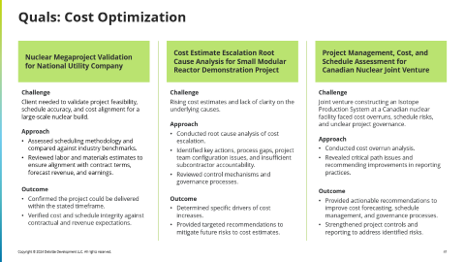
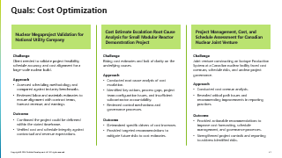
Quals: Supply Chain & Sourcing
Xx
Challenge
Xx
Approach
Xx
Outcome
Xx

Slide 45
Quals: Regulatory
Department of Energy (DOE) Loan Program Office (LPO)
Public Utility Commission of Texas (PUCT) Texas Energy Fund
U.S. NRC Scenario and Strategic Planning Support
Challenge
Support DOE’s underwriting of $17B+ in energy projects, including modular nuclear.
Ensure each project meets financial viability and risk management standards.
Approach
Performed independent financial viability assessments and risk analyses.
Applied lending industry norms, assessed creditworthiness, and advised on loan negotiations and documentation.
Outcome
Enabled DOE to make informed lending decisions.
Maintained portfolio integrity through rigorous, ongoing oversight.
Challenge
Stand up and operationalize the TEF to intake, review, award, and monitor loans and grants for Texas energy projects.
Ensure transparency, efficiency, and compliance in program execution.
Approach
Designed, deployed, and operationalized full loan/grant lifecycle systems.
Conducted market and credit analysis, supported loan negotiations, and provided public rulemaking support.
Managed funds, compliance monitoring, stakeholder engagement, and post-close transaction oversight.
Outcome
Delivered a fully functioning TEF program with clear governance and reporting.
Enabled streamlined, compliant funding decisions across the Texas energy sector.
Challenge
Help NRC prepare for multiple possible futures of the U.S. nuclear industry.
Approach
Conducted scenario research and facilitated workshops with NRC leadership.
Interviewed Commissioners, 20+ NRC staff, and 30+ global nuclear stakeholders.
Analyzed scenario impacts across NRC business lines and recommended actions.
Outcome
Delivered an actionable scenario outlook with strategic recommendations.
Supported NRC in aligning operations with evolving industry dynamics.

Slide 46
Quals: Other
Project Management, Cost, and Schedule Assessment for Canadian Nuclear Joint Venture
Challenge
Joint venture constructing an Isotope Production System at a Canadian nuclear facility faced cost overruns, schedule risks, and unclear project governance.
Approach
Conducted cost overrun analysis.
Revealed critical path issues and recommending improvements in reporting practices.
Outcome
Provided actionable recommendations to improve cost forecasting, schedule management, and governance processes.
Strengthened project controls and reporting to address identified risks.

Slide 47
Quals: Stakeholder Engagement
Stakeholder Outreach & Integration for Nuclear Generation Company
Stakeholder Engagement and Adoption Support for NERC’s Risk, Monitoring, and Enforcement Group
Challenge
Support integration planning for the company’s second major M&A transformation in four years.
Approach
Developed a fit-for-purpose stakeholder identification and outreach strategy.
Accounted for employee readiness, cultural norms, ways of working, and process/control needs.
Outcome
Increased transparency and employee engagement throughout the M&A process.
Challenges
Modernize compliance monitoring and enforcement processes affecting 1,500+ regulated energy companies.
Improve operational maturity while maintaining regulatory effectiveness.
Approach
Led process transformation and technology implementation for NERC’s Compliance Monitoring and Enforcement Program.
Spearheaded stakeholder identification, engagement, and adoption initiatives.
Outcome
Increased operational maturity and adoption of new processes and tools.
Enhanced efficiency and effectiveness across compliance operations.

Slide 48
Appendix

Slide 49
Buyer Types
DRAFT
The buyers outlined below are all c-level executives who we will target for our Nuclear Value chain. This list is not exhaustive, and buyers and their titles will vary across most organizations, regardless of industry / sector.
CEO
Chief Executive Officer
COO
Chief Operations Officer
CFO
Chief Financial Officer
CIO
Chief Information Officer
Executes the organization’s overall operations and develops both short and long-term vision and strategy
Responsible for overseeing the companies daily operations, optimizing processes, managing operational efficiencies and ensuring compliance
Ensures adequate liquidity and effective working capital management. Manages financial risks and ensuring compliance with regulations.
Oversees the IT Strategy, infrastructure and services that support the utilities operations. This involves ensuring the security, reliability and efficiency of systems
Role
How can we increase productivity and efficiency?
How can we reduce costs and drive revenue?
Do we have the right talent and skills in place to achieve our operational goals?
Are we fully compliant with all industry regulations and safety standards?
What is our current capital structure, and how does it support our growth objectives?
How can we optimize our capital expenditures to ensure maximum return on investment?
How can we increase productivity and efficiency?
How can we reduce costs and drive revenue?
Questions Asked
Supply Chain Management
Operational Costs & Efficiency
Capital Structure and Funding
Cybersecurity and Risk Management
Key Qual
Market and Policy Navigation
Supply Chain Management
Cost Management and Efficiency
Compliance and Regulatory Reporting

Slide 50
Buyer Types
DRAFT
The buyers outlined below are all c-level executives who we will target for our Nuclear Value chain. This list is not exhaustive, and buyers and their titles will vary across most organizations, regardless of industry / sector.
CTO
Chief Technology Officer
CINO
Chief Innovation Officer
CRO
Chief Risk Officer
Executes the organization’s overall operations and develops both short and long-term vision and strategy
Manages the process of innovation, identifying new business opportunities and technologies
Responsible for identifying, assessing and mitigating risks that may impact the company’s operations, financial performance and strategic objectives
Role
How can we leverage emerging technologies (i.e., digital twins) to advance business strategy and optimize operations?
What technology investments are necessary to achieve our long-term vision?
How can we leverage enterprise simulation technologies within our organization to develop new capabilities and new business models?
How do we ensure our waste management practices comply with industry standards and regulations?
What are the findings from recent audits, and how are we addressing any identified issues?
Questions Asked
Asset Efficiency
New Products / Services
Energy Policy
Key Qual
Product / Defect Metrics
Innovation ROI
Risk & Compliance

Slide 51

Challenges to Nuclear
An exploration of the primary obstacles and issues faced by the nuclear industry today.
63% Have waste management and disposal concerns
62% High initial capital costs
47% Regulatory and licensing challenges
47% public perception and acceptance
38% Technological maturity and reliability
30% Long development and construction timelines
*Deloitte’s 2024 power and utilities industry survey. Percentage of respondents

Slide 52



Why Change
Strategic Design & Planning
Construct & Build
Production & Operation
End Use
Design & Development
Financial Planning
Program Planning
Program Operations
Operations Preparation
Construction
Production
Operations & Maintenance
Storage & Transportation
Decommissioning
Dismantling
Stages
Strategic Development & Visioning
Financial Planning & Funding Strategy
Project Structuring & Governance
Budget Tracking & Control
Site Acquisition & Leasing
Supply Chain / Procurement Optimization
Fuel Supply Sourcing
Preventative Maintenance
Waste Management
Buyer / Lease Identification
Market & Economic Analysis
Regulatory & Compliance Analysis
Capital Allocation Planning & Management
Capital Prioritization & Reallocation
Asset Lifecycle Management
Tax Compliance & Incentive Utilization
Production Monitoring (Asset Monitoring)
Process Optimization
Route Optimization
Refurbishment & Decommissioning Planning
Energy Needs Assessment
JV Development & Structuring
Integrated Program Planning
Financial Reporting
License & Regulatory Planning & Permitting
Construction Vendor Selection & Management
Supply Negotiation & Optimization
Predictive Operations
Advanced Leak Detection for Nuclear Materials
Sustainability Goals
Structuring & Capital Optimization
Physical / Cyber Risk Assessment & Planning
Community Engagement & Workforce Enablement
Energy Mix & Procurement
Technology & Innovation Planning
Secure Operations
Value Chain Capabilities
Business Case & Business Planning
Due Diligence & Investor Readiness
Stakeholder Management
Debt Mgmt & Interest Rate Optimization
Outage Planning (e.g,. Resource & Workforce)
Construction Delivery Audit
Regulatory & Compliance Management
Tax Planning & Structuring
Stakeholder Engagement & Change Mgmt
Results Realization PMO
Waste Management Planning
Construction Sequencing & Progress
Regulatory Planning
Rate Case
UAV Construction Site Management
Site Identification & Validation
Vertical Capabilities
Licensing & Regulatory Planning
AI & Advanced Analytics
Emergency / Safety Management
Workforce Transformation
Copyright © 2025 Deloitte Consulting Pty Ltd. All rights reserved.
Notes:
SCRIPT
In addition to navigating the nuclear ecosystem to start building and scaling SMRs …
Organizations also need the capabilities to manage and operates the entire end-to-end lifecycle of each site.
It’s a complex, monolithic task.
NOTES
Combine those demands with your need to navigate the entire nuclear ecosystem from The demands of end to end.
Here’s what end to end looks like, and what you must account for to get to great.
You need to adapt to all the changes in buying behavior, business models, workforce, etc.
While also ensuring your organization is capable of handling every point of the nuclear lifecycle.
We’re using the capabilities: Here’s the enormity
Here’s what end to end looks like. Here’s what you need to achieve great.
This is the new landscape.
You have to do both of the simple things you saw above with a new level of complexity here.

Slide 53
Tailored Solutions for Nuclear Service Players
Our value lies in delivering customized solutions designed specifically for key players in the nuclear industry. By leveraging our deep industry expertise and comprehensive services, we can address the unique needs of our clients and drive innovation.
Investors
Broker relationships between manufacturers and SMR Operators / creators
Financial services (e.g. modeling)
Tax Planning and Strategy
Buy & sell side due diligence
Continue Reading >>
Engineering and Construction
Specialized PMO
Financial advisory
Digital Transformation & Modernization
Continue Reading >>
Nuclear Innovators
Broker relationships with an ecosystem of partners including Manufacturers and SMR operators
Financial and Tax advisory
End to end service provider
Continue Reading >>
Professional Services
Potential acquisition opportunities to enhance Deloitte’s expertise
Continue Reading >>
Insurers
Broker relationships with an ecosystem of partners
Digital Services such as business intelligence or data transformation
Climate Risk governance
Continue Reading >>
Manufacturers
Smart Manufacturing Practice (e.g. IP&C)
Forecasting demand of Parts
Broker relationships with SMR developers to understand what parts they will need to operate
Continue Reading >>

Slide 54
Tailored Solutions for Nuclear Operations Players
Our value lies in delivering customized solutions designed specifically for key players in the nuclear industry. By leveraging our deep industry expertise and comprehensive services, we can address the unique needs of our clients and drive innovation.
Fuel Providers
Forecasting demand of Materials
Digital Transformation & Modernization
Broker relationships with customers
Continue Reading >>
Generation
Digital Transformation & Modernization of operations
Results Realization PMO
Capital allocation
Continue Reading >>
Operators
Digital Transformation & Modernization of Operations
Forecasting demand
Broker relationships with customers
Continue Reading >>
Transmission
Broker relationships for permitting
AI & Digital Services
Financial & Tax advisory
Smart Utility
Continue Reading >>
Government
Resilient power supply & SMR technology
Feasibility analyses
Permitting
Governmental Funding
Continue Reading >>
Customers
Broker relationships between SMR Operators / creators
Financial services (e.g. modeling)
Energy Strategy & Management
Energy Procurement
Continue Reading >>

Slide 55
Buyer & Partner Analysis
DRAFT
An examination of potential buyers and eco-system strategic partners within the Nuclear industry
 | Generation | Nuclear Innovators (e.g. SMR Developers) | Investors
Description | Operates power generation or distribution assets. Most of the utilities who operate Nuclear plants are in the un-regulated market. | Developing state-of-the art nuclear technology (e.g., generation, cooling, fueling, maintenance, regulations, etc…), Developing Small Modular Reactor technology (e.g. SMR generation, SMR cooling, etc…) | Invests in nuclear power through acquisitions or power purchase agreements (e.g. PE Firms & Tech Companies)
Relationship Type | Buyer | Buyer & Ecosystem Partner | Buyer & Ecosystem Partner
Considerations | Efficient and cost-effective production of electricity Potentially works in the space already Understand regulations and operations Has a workforce that understands the operation, although it is aging May be developing SMRs | These companies are actively seeking partnerships with markets or players with high power demands (e.g. cryptocurrency firms, Data centers) | These companies or entities are typically looking to fix up and deploy assets for profitability and increased margin Nuclear Innovator players may be their clients (e.g. Microsoft + Constellation partnering to purchase an SMR)
Maturity Level (High, Medium,) Low | Wide Range Low to High Medium to High (e.g. Constellation) Low to Medium (e.g. Utilities getting into the space) | Low | Low - Medium
Key Issues | Expand the generation supply Procure their own fuel source Expand nuclear capabilities Aging and Specialized workforce Environmental, health and safety Security (IT/Physical) High capital and operating costs | Decrease time to market to reach profitability Maximize their capital (e.g. tax incentives, ways to partner to obtain financing) Supply chain and manufacturing Funding / Capital sourcing Experienced workforce Standardized designs for licensing, permitting and safety | Uncertainty of returns Finding a market or client to buy their product Opportunity identification
Why Deloitte? | Industry Expertise and organizational maturity Digital Transformation & Modernization Financial and Tax services End to end service and Journey client partner Alliance partnerships Results Realization PMO Capital allocation, Operational efficiency Modernizing operations, predictive maintenance/operations Stakeholder engagement Workforce Transformation | Industry Expertise and organizational maturity Broker relationships with an ecosystem of partners including Manufacturers and SMR operators Digital Services Financial and Tax advisory End to end service provider Journey client partner Results Realization PMO Stakeholder engagement | Broker relationships between manufacturers and SMR Operators / creators Financial services (e.g. modeling) Tax Planning and Strategy Buy side due diligence Sell side due diligence Post-deal integration Operational improvement De-risking strategies Stakeholder engagement
C-Level / Executive Buyers | Chief Executive Officer Chief Operations Officer Chief Finance Officer Chief Risk Officer ? Or Chief Information Office Supply Chain / Procurement Lead | Chief Executive Officer Chief Technology Officer | List

Slide 56
Buyer & Partner Analysis
DRAFT
An examination of potential buyers and eco-system strategic partners within the Nuclear industry
 | Customers | Transmission | Engineering & Construction
Description | Nuclear energy consumers can be categorized into commercial sectors (e.g., manufacturing plants, data centers), residential sectors (e.g., households, apartment complexes), and government sectors (e.g., military bases, DOD), each utilizing nuclear power for various operational, domestic, and institutional needs. | Responsible for transporting electricity from generation facilities to distribution networks and large consumers.(e.g. Exelon) | Designing nuclear power components and managing end-to-end construction of nuclear assets
Relationship Type | Buyer & Ecosystem Partner | Buyer & Ecosystem Partner | Buyer & Ecosystem Partner
Considerations | Finding a robust and cost effective energy source to fuel their energy demands On grid vs off grid | Understanding generation mix and integration, capacity, demand patterns, weather resilience, environmental impacts and policy goals Long-term planning to accommodate changing energy sources, demand patterns, and evolving technologies
Maturity Level (High, Medium,) Low | Wide Range: Low to High | Medium to High | Low - Medium
Key Issues | Energy security and supply Energy Costs and Economic viability Sanctions Management Reliability and Outages Public Safety and Environmental Impact | Regulatory compliance (FERC) & interacting with multi state jurisdictions Growing energy demands Grid modernization Rate Case Filings Vegetation Management / environmental concerns (i.e. wildfires) Long term planning (Compliance for FERC 1920) | Looking to expand their Nuclear capabilities and projects Planning and construction timelines Permitting and Licensing
Why Deloitte? | Broker relationships between SMR Operators / creators Financial services (e.g. modeling) Post-deal integration Operational improvement Energy Strategy & Management Energy Procurement | Broker relationships for permitting AI & Digital Services Financial & Tax advisory Smart Utility Regulatory Compliance | Digital Transformation & Modernization Financial advisory Specialized PMO Compliance strategy Security De-risking strategies
C-Level / Executive Buyers | Chief Operations Officer Chief Finance Officer City / Municipal Governments (PPA) DOD and DOE Officials | Chief Operations Officer Chief Finance Officer Chief Technology Officer City / Municipal Governments (PPA)??
Notes:
Accident Tolerant Fuels: https://www.energy.gov/ne/articles/these-accident-tolerant-fuels-could-boost-performance-todays-reactors
Insurance: https://www.nrc.gov/reading-rm/doc-collections/fact-sheets/nuclear-insurance.html
Insurance: https://crsreports.congress.gov/product/pdf/IF/IF10821
Insurance: https://www2.deloitte.com/content/dam/Deloitte/us/Documents/risk/us-aers-grc-enterprise-risk-management-for-energy-industry-110413.pdf

Slide 57
Buyer & Partner Analysis
DRAFT
*Need validation or more input
An examination of potential buyers and eco-system strategic partners within the Nuclear industry
 | Fuel Providers | Manufacturers | Operators
Description | Sources, manufactures, and supplies nuclear fuel (e.g., uranium, fuel rods, etc…) | Manufactures nuclear power components for commercial use | Manages the operations of existing nuclear assets (e.g., daily operations, maintenance, reporting, waste, etc…)
Relationship Type | Buyer & Ecosystem Partner | Buyer & Ecosystem Partner | Buyer & Ecosystem Partner
Considerations | New sources of minerals like thorium or accident tolerance fuels Low supply of uranium due to sanctions
Maturity Level (High, Medium,) Low | High | High | High
Key Issues | Supply chain risk Sanctions management Competition with other renewable sources? | Expand their client base Skills gap New Technology adoption to support new parts and equipment needed Demand planning and prediction Standardized designs for licensing, permitting and safety | Aging Talent and Workforce Disaster recovery and mitigation Compliance Expand their business Technology adoption
Why Deloitte? | Digital Transformation & Modernization Forecasting demand of Materials Broker relationships with customers | Smart Manufacturing Practice (e.g. IP&C) Forecasting demand of Parts Broker relationships with SMR developers to understand what parts they will need to operate Digitize their operations | Digital Transformation & Modernization of Operations Forecasting demand Broker relationships with customers
C-Level / Executive Buyers
Notes:
Accident Tolerant Fuels: https://www.energy.gov/ne/articles/these-accident-tolerant-fuels-could-boost-performance-todays-reactors

Slide 58
Buyer & Partner Analysis
DRAFT
An examination of potential buyers and eco-system strategic partners within the Nuclear industry
 | Professional Services | Insurers | Government
Description | Professional services refer to specialized services provided by experts who possess a high degree of training and expertise in their respective fields. (e.g. improve operations, tax services, strategy, audit and assurance, risk advisory, talent development, financial advisory and technology services) | Specialized insurance coverage and financial protection for the nuclear industry including Operational Risk, Liability coverage, construction and development, accidents and incident response. Nuclear insurance requires specialized underwriting expertise due to the unique and complex nature of nuclear risks. | The government's involvement in the nuclear industry is multifaceted, encompassing regulation, funding, research and development, policy-making, and international cooperation.
Relationship Type | Ecosystem Partner | Ecosystem Partner | Buyer
Considerations |  | Price-Anderson became law on Sept. 2, 1957, to cover liability claims of members of the public for personal injury and property damage caused by a commercial nuclear power plant accident. | Department of Armed Forces are working on first micro reactor project in Alaska on Eleison Airforce Base Procurement for the pilot is currently on pause due to environmental and societal audits
Maturity Level (High, Medium,) Low | Low - High | Medium - High | Medium
Key Issues |  | Climate change can disrupt operations and create risks Insurers must stay up to date on the latest technology to ensure they meet safety standards Regulatory changes and requirements are difficult to navigate Radioactive waste disposal | Safe secure generation Nuclear waste management Environmental concerns & sustainable practices International Cooperation and non-proliferation Public and societal perception
Why Deloitte? | Potential acquisition opportunities to enhance Deloitte’s expertise | Broker relationships with an ecosystem of partners including Manufacturers and SMR operators Digital Services such as business intelligence or data transformation Climate Risk governance Regulatory compliance and risk management | Digital Transformation & Modernization of Operations Security De-risking strategies
C-Level / Executive Buyers
Notes:
Accident Tolerant Fuels: https://www.energy.gov/ne/articles/these-accident-tolerant-fuels-could-boost-performance-todays-reactors
Insurance: https://www.nrc.gov/reading-rm/doc-collections/fact-sheets/nuclear-insurance.html
Insurance: https://crsreports.congress.gov/product/pdf/IF/IF10821
Insurance: https://www2.deloitte.com/content/dam/Deloitte/us/Documents/risk/us-aers-grc-enterprise-risk-management-for-energy-industry-110413.pdf

Slide 59
Competitors
Add info on what they are doing with AI
The following players are pioneering innovations and setting standards in Nuclear technology, safety and operations. The below analysis considers
Professional Service Firms
PWC | McKinsey & Co | Boston Consulting Group | Bain & Company | FTI Consulting | Solestiss | West Monroe Partners
Strategy & Financing Contracting & Delivery Start-up Operations & Maintenance Decommissioning and Disposal Supply Chain & Material Sourcing Engineering Legal & Regulatory IT Safety Tax Audit and Assurance | Strategy & Planning Construction & Refurbishment Operations Decommissioning Nuclear Fuel AI & Advanced Analytics | Nuclear Asset Strategy PMO Capital Project Planning Supply Chain Operations Market Design & Regulatory Reviews AI & Data | Strategy & Planning Operations Supply Chain & Procurement M&A Accelerated Performance Transformation Organizational Design & Operating Model Capital Planning Grid Capital Planning | Strategic Planning Reactor construction Operations & Decommissioning Financial & Regulatory Analysis ESG & Sustainability Cybersecurity Public & Government Affairs Media Relations & Crisis Communications | Market Assessment Technology Assessment Plant Buy / Sell Commercialization | End-to-End M&A Cost Optimization Finance Operations Supply Chain Operations Regulatory Planning Workforce Management AI & Advanced Analytics
E&C Firms
Bechtel | Black & Veatch | Jacobs
Large Scale Reactor Construction EPC Partners w/ SMR Developers Major Modifications of Existing Reactors | Reactor Optimization Safety Compliance Plant Modification Fuel Storage Solutions Procurement Transaction Advisory Regulation Advisory Cybersecurity | SMR Development Microreactor Development Project Management Decommissioning

Slide 60
Types of Key Players
DRAFT
An examination of potential buyers and eco-system strategic partners within the Nuclear industry
Service Providers
Operations
Governing Bodies & NGOs
Title | Definition
Investor | Invests in nuclear power through acquisitions or power purchase agreements
Nuclear Innovators | Developing state-of-the art nuclear technology (e.g., SMR development, desalinization, generation, cooling, fueling, maintenance, regulations, etc…)
Manufacturing | Manufactures nuclear power components for commercial use
Engineering & Construction Firms | Designing nuclear power components and managing end-to-end construction of nuclear assets
Legal | Manages the relationship between utilities, developers, and regulators and helps organizations navigate the existing regulatory environment
Insurers | Responsible for providing coverage (during construction and operations) for property damage, bodily injury, and environmental cleanup costs at a nuclear facility as well as transportation of nuclear fuel and waste
Professional Services | Professional services refer to specialized services provided by experts who possess a high degree of training and expertise in their respective fields. (e.g. improve operations, tax services, strategy, audit and assurance, risk advisory, talent development, financial advisory and technology services)
Title | Definition
Utilities (Generation) | Responsible for producing electricity. Operates power generation, or distribution assets (e.g. Utilities)
Utilities (Transmission) | Responsible for transporting electricity from generation facilities to distribution networks and large consumers.(e.g. Exelon)
Consumers | Commercial (e.g. Data Centers, Technology Companies, Plants, Medical facilities/technology), Residential, Gov’t Bodies (e.g. DOD, Space Program)
Operations | Manages the operations of existing nuclear assets (e.g., daily operations, energy management, maintenance, reporting, waste, etc…)
Nuclear Fuel | Sources, manufactures, and supplies nuclear fuel (e.g., uranium, fuel rods, etc…)
Workforce | Manages the sourcing and deployment of nuclear talent (e.g., engineers, operators, etc…)
Title | Definition
Non-profit Research | Conducts non-commercial nuclear research made available to the public
Regulator | Enforces laws pertaining to nuclear energy and nuclear asset development
NGOs & Alliances | Facilitates relationships within the nuclear industry and advocates for inudstry-supporting legislation

